Slide 1
CH6 Pairs Selection in Equity Markets

Slide 2
Agenda
Introduction
Common trends cointegration model
Common trends model and APT
The distance measure
Interpreting the distance measure
Reconciling theory and practice

Slide 3
Introduction
In this chapter , we focus on Identification of stock pairs.
This book give us a method :
Each pair is associated with a score/distance measure.
- The higher the score , the greater the degree of comovement , and vice versa.
A proper choice of the score measure become a key to the pairs selection process.
If we find that a pair is unsuitable for pairs trading , then the score of other pairs which lower than this pair is also unsuitable.
We will find the nexus between cointegration and arbitrage pricing theory (APT)

Slide 4
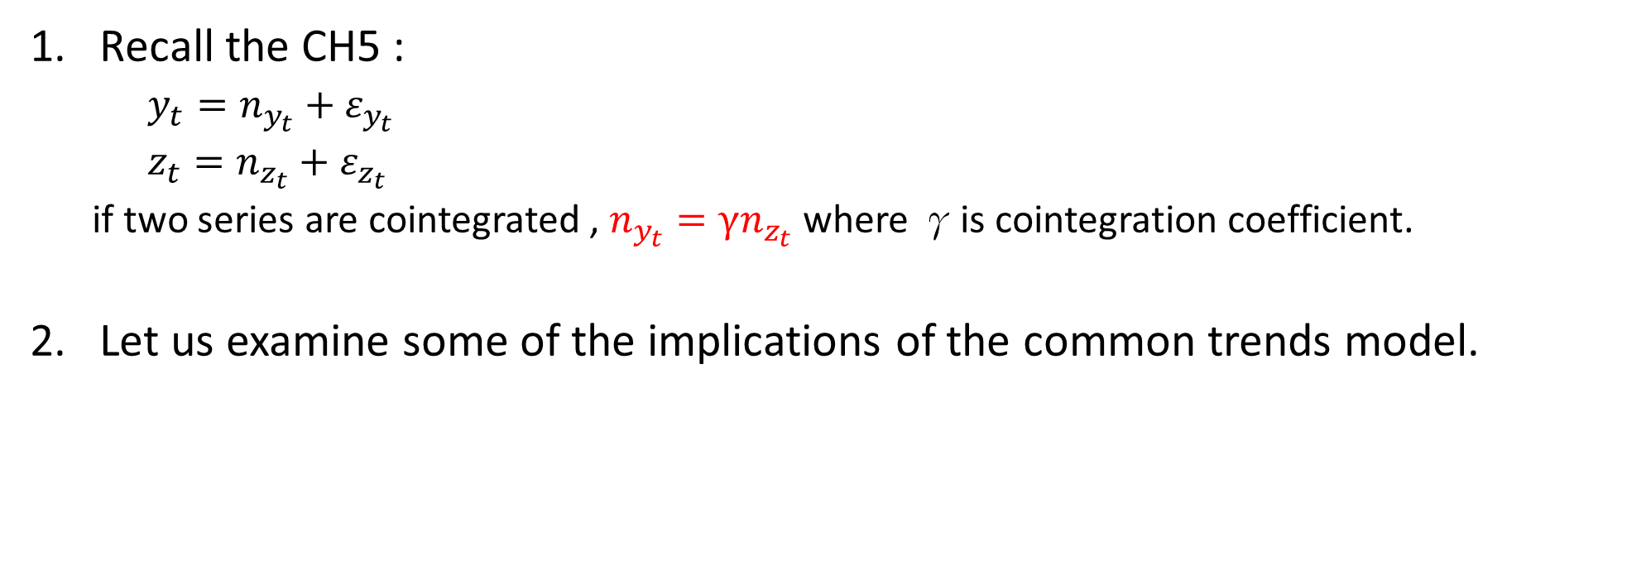
Common trends cointegration model
Recall the CH5 :
$y_{t}=n_{y_{t}}+ε_{y_{t}}$
$z_{t}=n_{z_{t}}+ε_{z_{t}}$
if two series are cointegrated , $n_{y_{t}}=γn_{z_{t}}$ where γis cointegration coefficient.
Let us examine some of the implications of the common trends model.

Slide 5

Common trends cointegration model
Inference 1 :
In a cointegrated system with two time series, the innovations sequences
derived from the common trend components must be perfectly correlated.
(Correlation value must be +1 or –1).
<Explanation>
The innovations sequences of common trend components is :
$n_{y_{t+1}}−n_{y_{t}}=r_{y_{t+1}} and n_{z_{t+1}}−n_{z_{t}}=r_{z_{t+1}}$
We know that : $n_{y_{t}}=γn_{z_{t}}⇒n_{y_{t+1}}=γn_{z_{t+1}}$ , So $r_{y_{t+1}}=γr_{z_{t+1}}$ .
Then , $corr\left(r_{y_{t+1}},r_{z_{t+1}}\right)=\frac{cov\left(r_{y_{t+1}},r_{z_{t+1}}\right)}{\sqrt{var(r_{y_{t+1}})}\sqrt{var(r_{z_{t+1}})}}=\frac{γ∗var(r_{z_{t+1}})}{\sqrt{γ^{2}}{\left(\sqrt{var(r_{z_{t+1}})}\right)}^{2}}=\frac{γ}{\sqrt{γ^{2}}}=\frac{γ}{\left|γ\right|}$
if $γ>0 ,$ $corr\left(r_{y_{t+1}},r_{z_{t+1}}\right)=1 ,γ<0 , corr\left(r_{y_{t+1}},r_{z_{t+1}}\right)=−1$
So , the two variables are identical up to a scalar.
Notes:
由一般趨勢項所推導出來的seq應該

Slide 6

Common trends cointegration model
Inference 2 :
The cointegration coefficient may be obtained by a regression of the
innovation sequences of the common trends against each other.
<Explanation>
$r_{y_{t}}=γr_{z_{t}}⇒Cov\left(r_{y_{t}},r_{z_{t}}\right)=Cov\left(γr_{z_{t}},r_{z_{t}}\right)=γCov\left(r_{z_{t}},r_{z_{t}}\right)=γVar\left(r_{z_{t}}\right)$
$∴γ=\frac{Cov\left(r_{y_{t}},r_{z_{t}}\right) }{Var\left(r_{z_{t}}\right) }$

Slide 7
Common trends cointegration model
Discussion:
The correlation of the innovation sequences of common trend component and whole series are difference.
If cointegration exist, the specific component is absolutely necessary to be stationary.
The first difference of the specific component must not be white noise, because if the differenced series were white noise, then the specific series would be a random walk, a nonstationary series.
Notes:
前面只有提到RW項的相關係數,現在要計算整條Series的相關係數:1.一般趨勢項的IS跟整條的Inno-Series,他們的correlation計算方法不同 2.沒有限制的時候CT它可以是定態也可以是非定態,但卻不是影響共整合的最大原因,所以最重要的因素是特別向的部分必須是定態 根據1跟2 我們可以知道說 特別項的一階差分不可以為白噪音數列 不然原本的特別項就會是RW 有為被原本 特別項是定態的假設

Slide 8
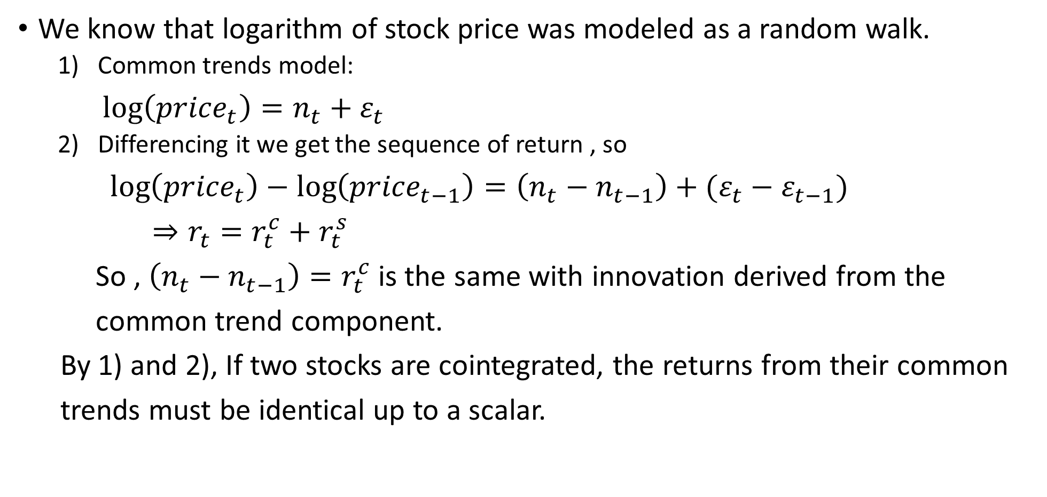
Common trends model and APT
We know that logarithm of stock price was modeled as a random walk.
Common trends model:
$\log\left({price}_{t}\right)=n_{t}+ε_{t}$
Differencing it we get the sequence of return , so
$\log\left({price}_{t}\right)−\log\left({price}_{t−1}\right)=\left(n_{t}−n_{t−1}\right)+(ε_{t}−ε_{t−1})$
$⇒r_{t}=r_{t}^{c}+r_{t}^{s}$
So , $\left(n_{t}−n_{t−1}\right)=r_{t}^{c}$is the same with innovation derived from the
common trend component.
By 1) and 2), If two stocks are cointegrated, the returns from their common
trends must be identical up to a scalar.
Notes:
如果我們要回到股票資料的問題 唯一可行的應用就是我們要把時間序列拆成Sta跟Nonsta 所以必須建立 APT跟CTM的關係

Slide 9
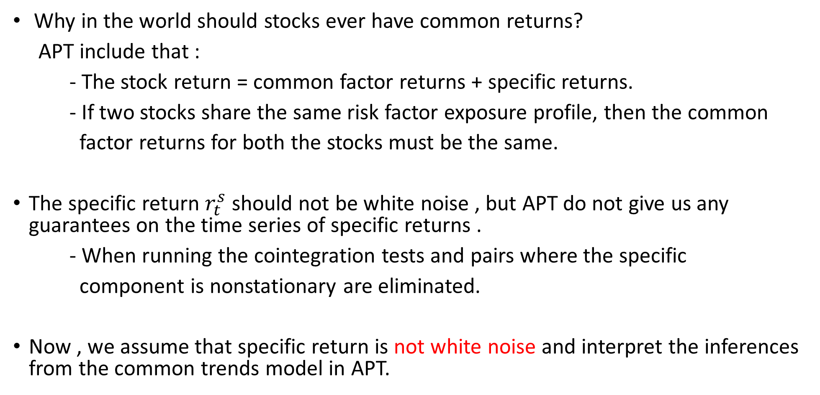
Common trends model and APT
Why in the world should stocks ever have common returns?
APT include that :
- The stock return = common factor returns + specific returns.
- If two stocks share the same risk factor exposure profile, then the common
factor returns for both the stocks must be the same.
The specific return $r_{t}^{s}$ should not be white noise , but APT do not give us any guarantees on the time series of specific returns .
- When running the cointegration tests and pairs where the specific
component is nonstationary are eliminated.
Now , we assume that specific return is not white noise and interpret the inferences from the common trends model in APT.
Notes:
APT是一個單一時點的架構而且也不能給時間序列的Spec R 擔保.必須假設Spec r部份不時白噪音 但可以透過共整合檢定

Slide 10
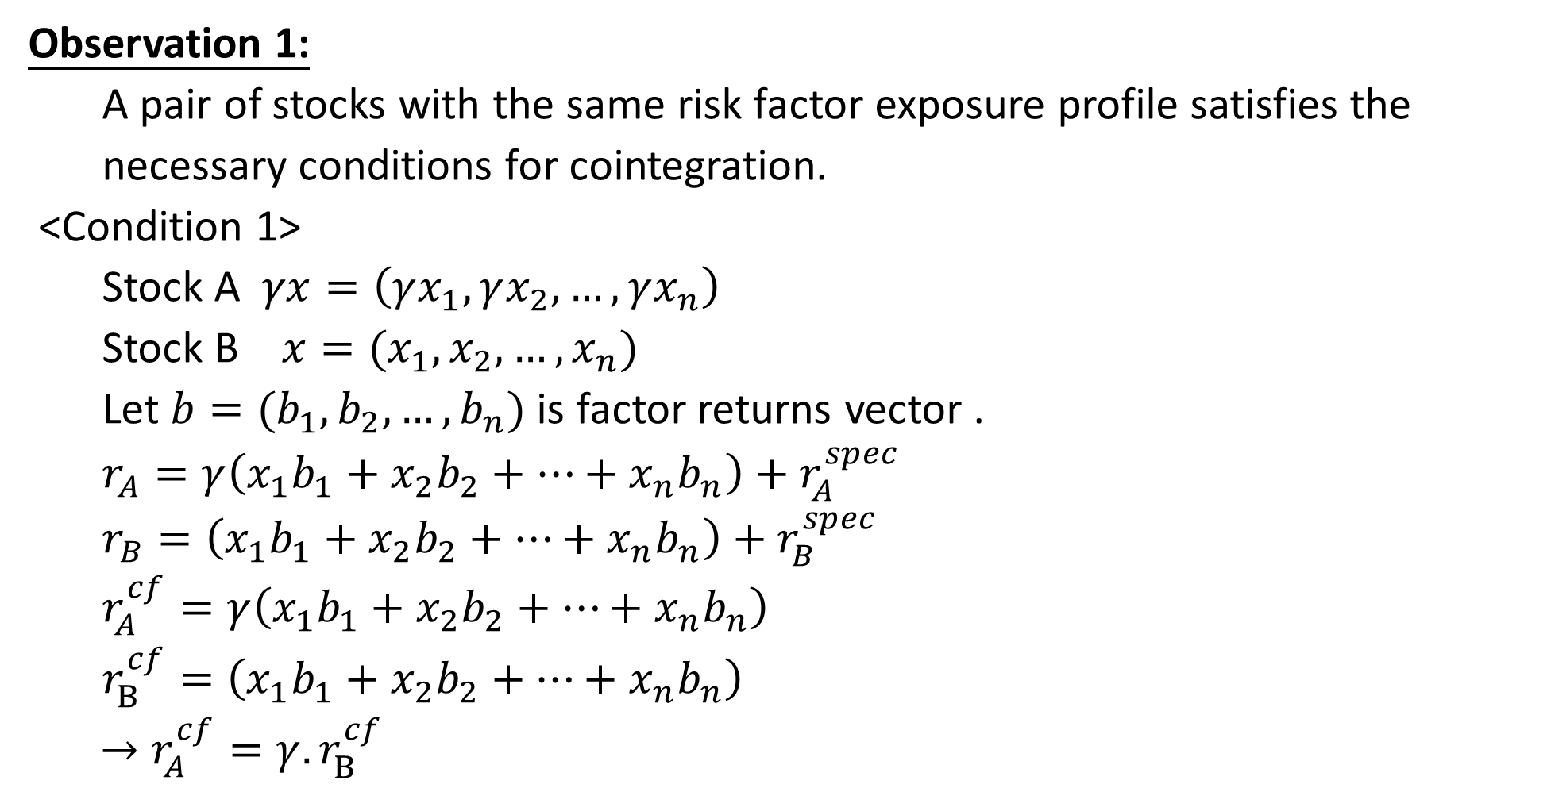
Common trends model and APT
Observation 1:
A pair of stocks with the same risk factor exposure profile satisfies the
necessary conditions for cointegration.
<Condition 1>
Stock A $γx=\left(γx_{1},γx_{2},…,γx_{n}\right)$
Stock B $x=(x_{1},x_{2},…,x_{n})$
Let $b=(b_{1},b_{2},…,b_{n})$ is factor returns vector .
$r_{A}=γ\left(x_{1}b_{1}+x_{2}b_{2}+…+x_{n}b_{n}\right)+r_{A}^{spec}$
$r_{B}=\left(x_{1}b_{1}+x_{2}b_{2}+…+x_{n}b_{n}\right)+r_{B}^{spec}$
$r_{A}^{cf}=γ\left(x_{1}b_{1}+x_{2}b_{2}+…+x_{n}b_{n}\right)$
$r_{B}^{cf}=\left(x_{1}b_{1}+x_{2}b_{2}+…+x_{n}b_{n}\right)$
$→r_{A}^{cf}={γ.r}_{B}^{cf}$
The factor exposure are identical up to scalar.
Notes:
滿足共整合的第一個條件

Slide 11
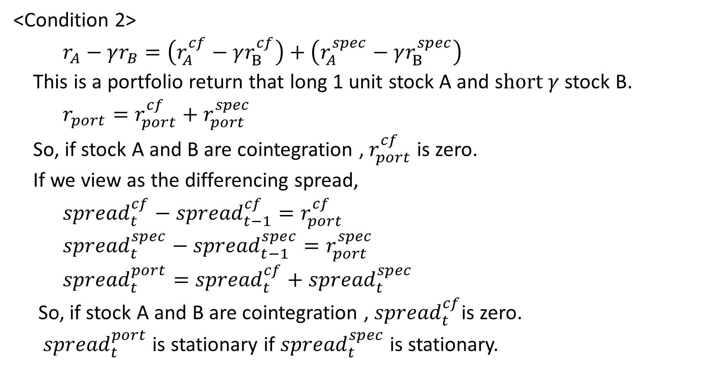
Common trends model and APT
<Condition 2>
$r_{A}−γr_{B}=\left(r_{A}^{cf}−γr_{B}^{cf}\right)+\left(r_{A}^{spec}−γr_{B}^{spec}\right)$
This is a portfolio return that long 1 unit stock A and s$hort γ$ stock B.
$r_{port}=r_{port}^{cf}+r_{port}^{spec}$
So, if stock A and B are cointegration , $r_{port}^{cf}$ is zero.
If we view as the differencing spread,
${spread}_{t}^{cf}−{spread}_{t−1}^{cf}=r_{port}^{cf}$
${spread}_{t}^{spec}−{spread}_{t−1}^{spec}=r_{port}^{spec}$
${spread}_{t}^{port}={spread}_{t}^{cf}+{spread}_{t}^{spec}$
So, if stock A and B are cointegration , ${spread}_{t}^{cf}$is zero.
${spread}_{t}^{port}$ is stationary if ${spread}_{t}^{spec}$ is stationary.

Slide 12
The distance measure
Now , we will go into the distance measure , we have already know:
The innovation sequences derived from the common trends must be perfectly correlated.
The common factor return of the APT model might be interpreted as the innovations derived from the common trends.
We will explain that the distance measure is the absolute value of the correlation of the common factor returns.

Slide 13
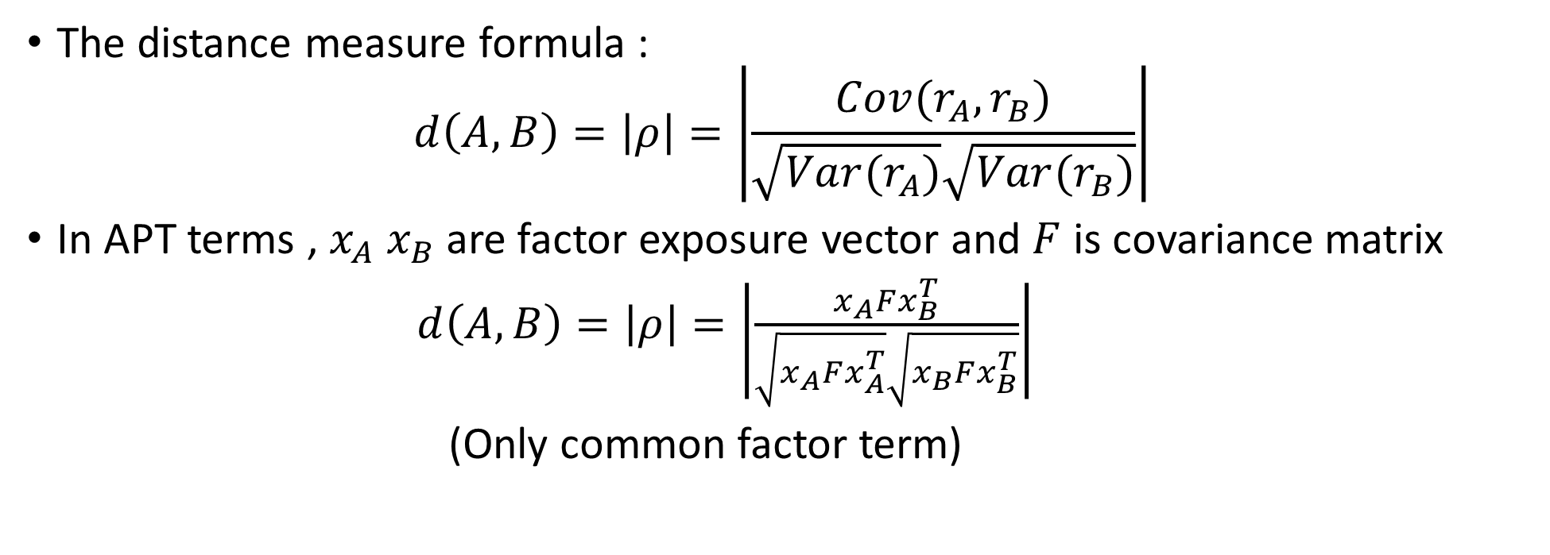
The distance measure
The distance measure formula :
$$d\left(A,B\right)=\left|ρ\right|=\left|\frac{Cov(r_{A},r_{B})}{\sqrt{Var(r_{A})}\sqrt{Var(r_{B})}}\right|$$
In APT terms , $x_{A} x_{B}$are factor exposure vector and $F$ is covariance matrix
$d\left(A,B\right)=\left|ρ\right|=\left|\frac{x_{A}Fx_{B}^{T}}{\sqrt{x_{A}Fx_{A}^{T}}\sqrt{x_{B}Fx_{B}^{T}}}\right|$
(Only common factor term)

Slide 14

Interpreting the distance measure
In this section , we will show that the correlation measure
$d\left(A,B\right)=\left|ρ\right|=\left|\frac{x_{A}Fx_{B}^{T}}{\sqrt{x_{A}Fx_{A}^{T}}\sqrt{x_{B}Fx_{B}^{T}}}\right|$
can be interpreted as the cosine of the angle between transformed versions of
the factor exposure vectors corresponding to the two stocks.

Slide 15
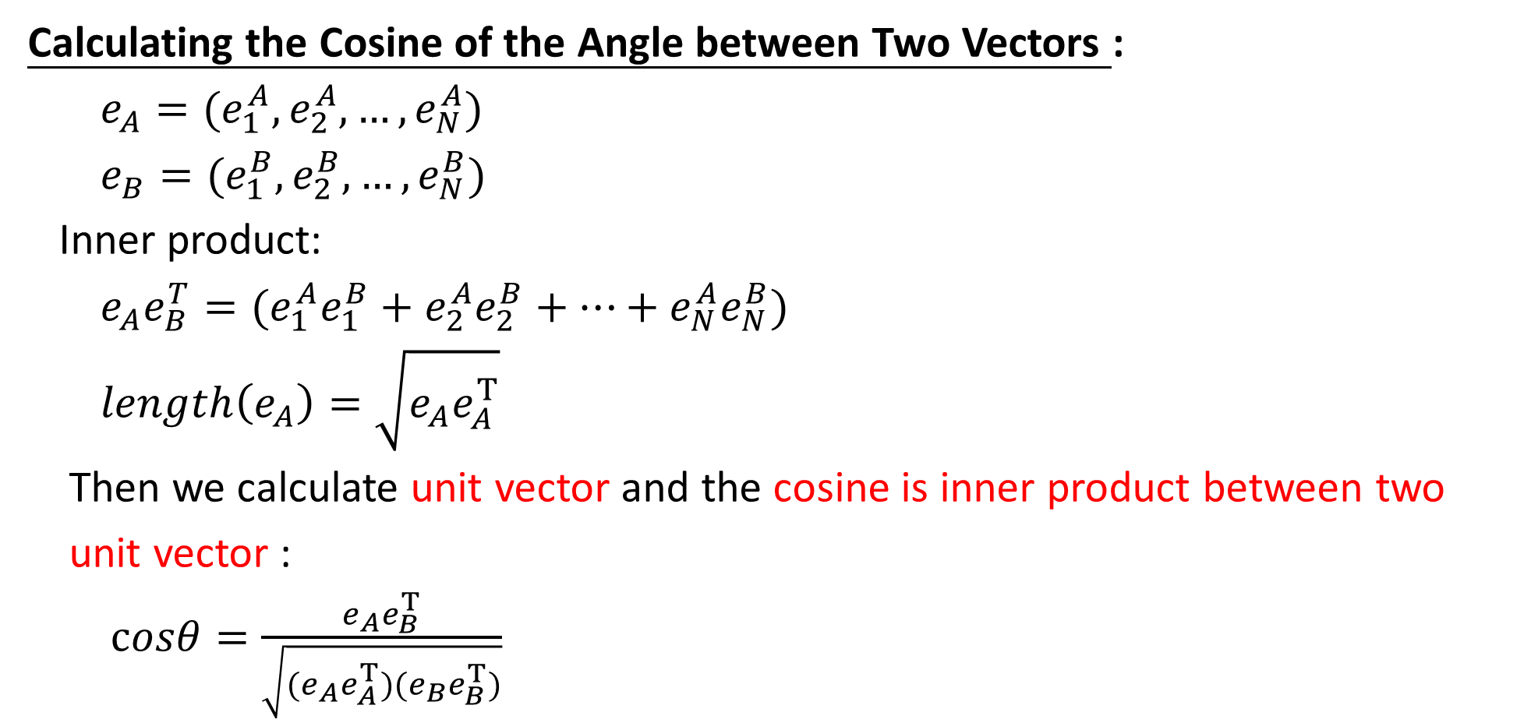
Interpreting the distance measure
Calculating the Cosine of the Angle between Two Vectors :
$e_{A}=(e_{1}^{A},e_{2}^{A},…,e_{N}^{A})$
$e_{B}=(e_{1}^{B},e_{2}^{B},…,e_{N}^{B})$
Inner product:
$e_{A}e_{B}^{T}=(e_{1}^{A}e_{1}^{B}+e_{2}^{A}e_{2}^{B}+…+e_{N}^{A}e_{N}^{B})$
$length\left(e_{A}\right)=\sqrt{e_{A}e_{A}^{T}}$
Then we calculate unit vector and the cosine is inner product between two
unit vector :
$cosθ=\frac{e_{A}e_{B}^{T}}{\sqrt{{(e}_{A}e_{A}^{T})(e_{B}e_{B}^{T})}}$

Slide 16
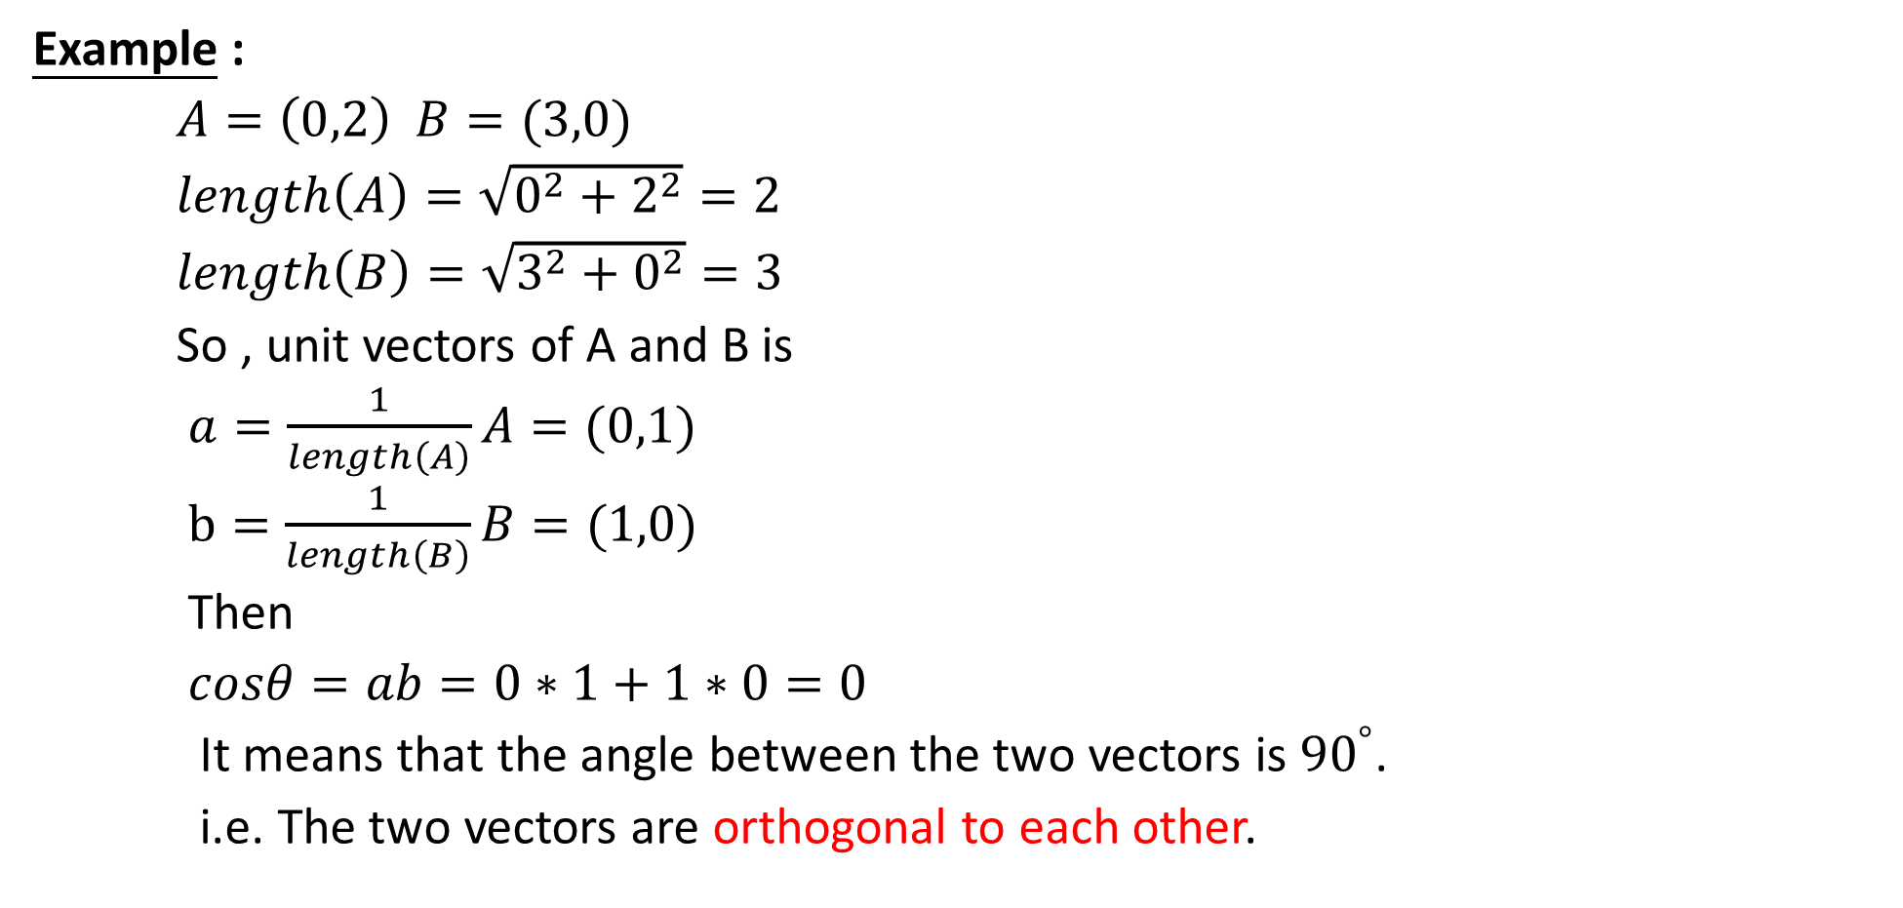
Common trends model and APT
Example :
$A=\left(0,2\right) B=(3,0)$
$length\left(A\right)=\sqrt{0^{2}+2^{2}}=2$
$length\left(B\right)=\sqrt{3^{2}+0^{2}}=3$
So , unit vectors of A and B is
$a=\frac{1}{length\left(A\right)}A=(0,1)$
$b=\frac{1}{length\left(B\right)}B=(1,0)$
Then
$cosθ=ab=0∗1+1∗0=0$
It means that the angle between the two vectors is ${90}^{°}$.
i.e. The two vectors are orthogonal to each other.

Slide 17
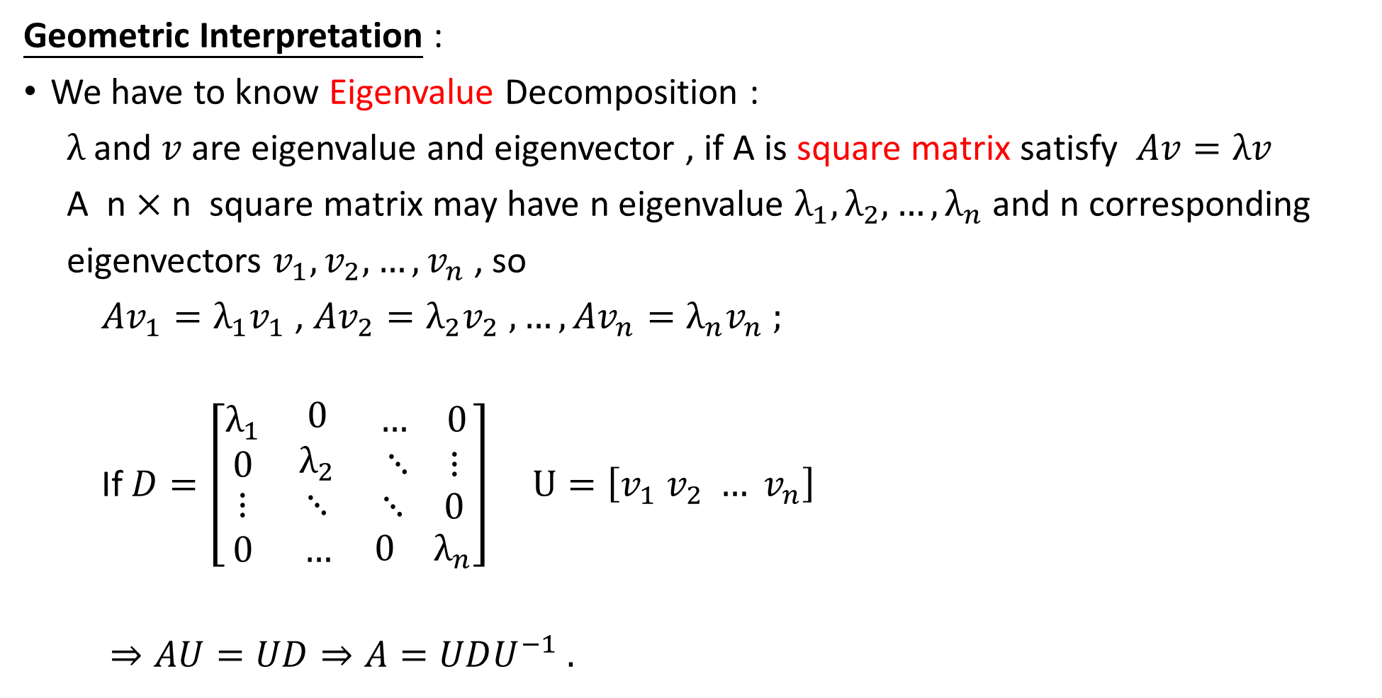
Common trends model and APT
Geometric Interpretation :
We have to know Eigenvalue Decomposition :
$λ$ and $v$ are eigenvalue and eigenvector , if A is square matrix satisfy $Av=λv$
A n $×$ n square matrix may have n eigenvalue $λ_{1},λ_{2},…,λ_{n}$ and n corresponding
eigenvectors $v_{1},v_{2},…,v_{n}$ , so
${Av}_{1}=λ_{1}v_{1}$ , ${Av}_{2}=λ_{2}v_{2} , …, {Av}_{n}=λ_{n}v_{n} ;$
If $D=\left[\begin{matrix}\begin{matrix}λ_{1} \\ 0\end{matrix} & \begin{matrix}0 \\ λ_{2}\end{matrix} & \begin{matrix}\begin{matrix}… & 0\end{matrix} \\ \begin{matrix}⋱ & ⋮\end{matrix}\end{matrix} \\ ⋮ & ⋱ & \begin{matrix}⋱ & 0\end{matrix} \\ 0 & … & \begin{matrix}0 & λ_{n}\end{matrix}\end{matrix}\right]$ $U=\left[v_{1} v_{2} … v_{n}\right]$
$⇒AU=UD⇒A=UDU^{−1} .$

Slide 18
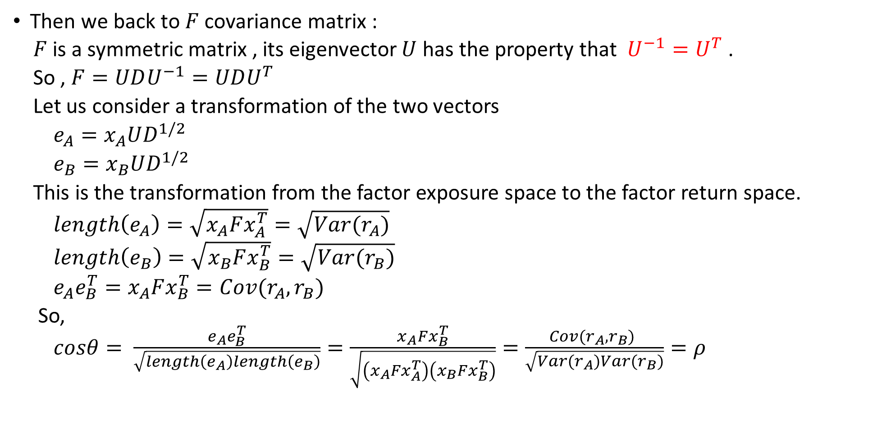
Common trends model and APT
Then we back to $F$ covariance matrix :
$F$ is a symmetric matrix , its eigenvector $U$ has the property that $U^{−1}=U^{T}$ .
So , $F=UDU^{−1}=UDU^{T}$
Let us consider a transformation of the two vectors
$e_{A}=x_{A}UD^{1/2}$
$e_{B}=x_{B}UD^{1/2}$
This is the transformation from the factor exposure space to the factor return space.
$length\left(e_{A}\right)=\sqrt{x_{A}Fx_{A}^{T}}=\sqrt{Var(r_{A})}$
$length\left(e_{B}\right)=\sqrt{x_{B}Fx_{B}^{T}}=\sqrt{Var(r_{B})}$
$e_{A}e_{B}^{T}=x_{A}Fx_{B}^{T}=Cov(r_{A},r_{B})$
So,
$cosθ= \frac{e_{A}e_{B}^{T}}{\sqrt{length\left(e_{A}\right)length\left(e_{B}\right)}}=\frac{x_{A}Fx_{B}^{T}}{\sqrt{\left(x_{A}Fx_{A}^{T}\right)\left(x_{B}Fx_{B}^{T}\right)}}=\frac{Cov(r_{A},r_{B}) }{\sqrt{Var(r_{A})Var(r_{B})}}=ρ$

Slide 19
Reconciling theory and practice
Stationarity of integrated specific returns:
Using cointegration test to evaluate the common factor and specific returns for each
time period.
Cointegration test :
Estimation of the cointegration coefficient
Ensuring that the spread series of the long–short portfolio constructed with this ratio is indeed stationary.
Notes:
說完定理之後 我們接這要把定理與實際操作做一個結合,

Slide 20
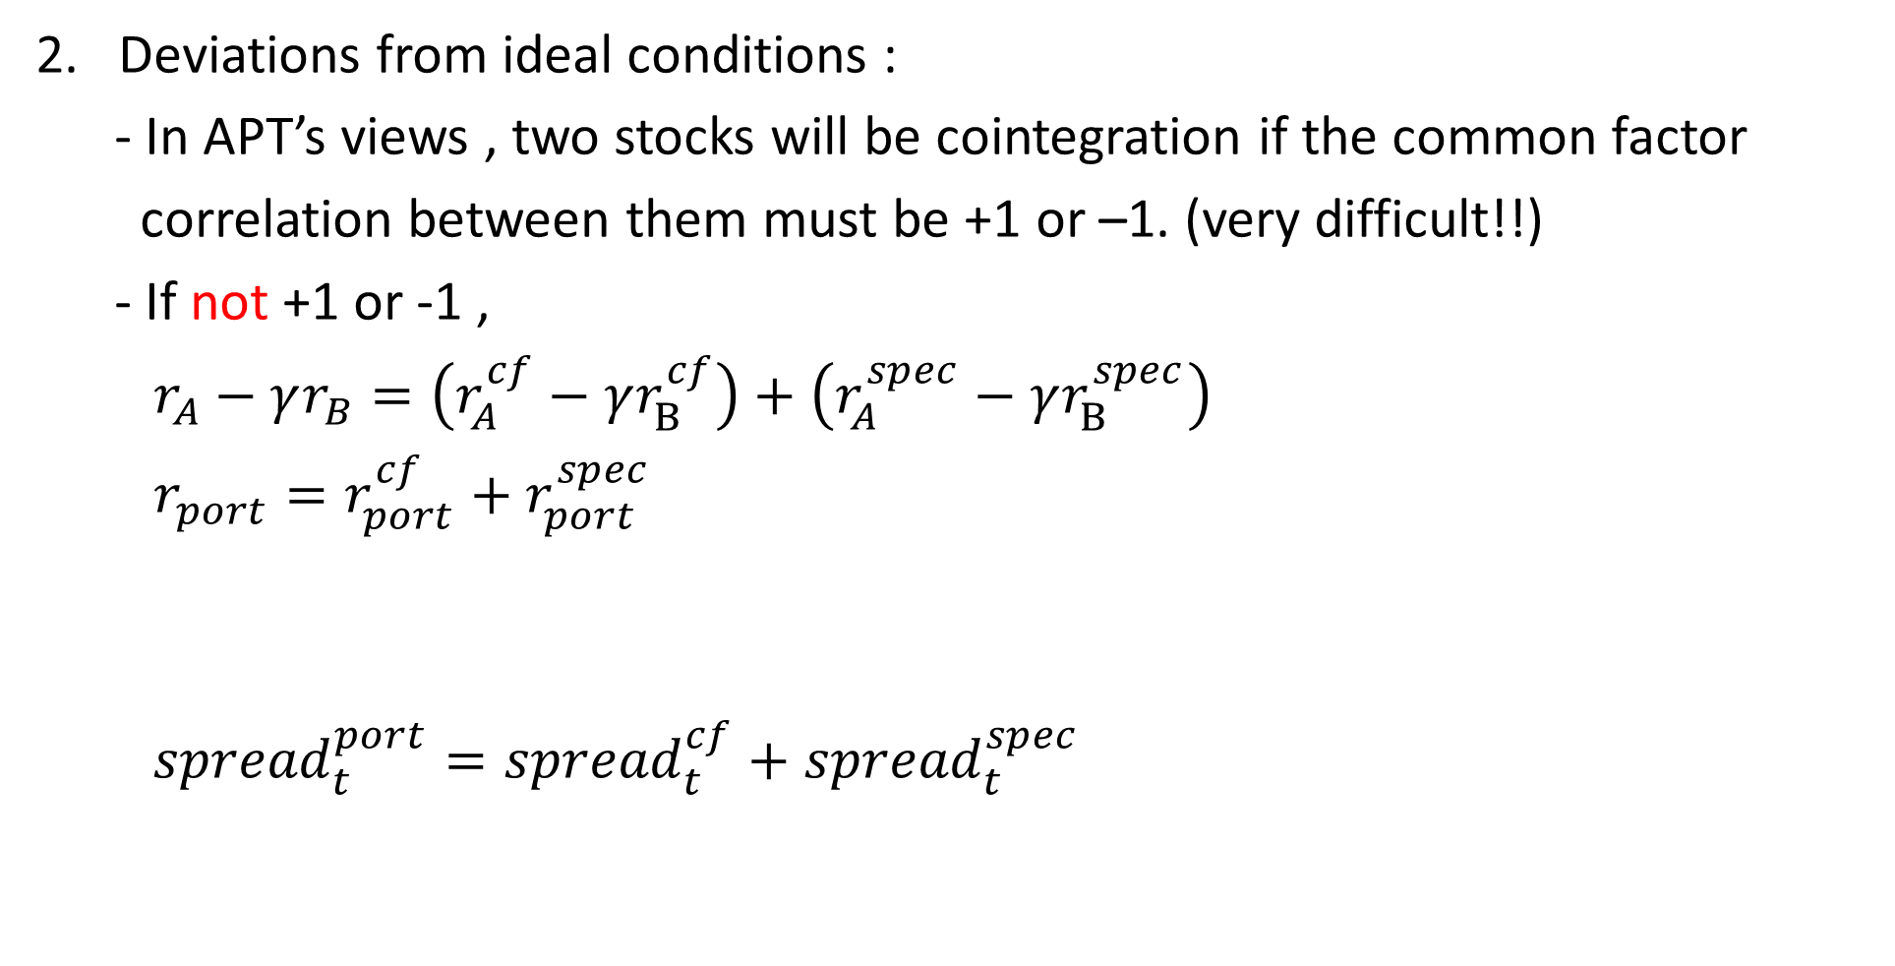
Reconciling theory and practice
Deviations from ideal conditions :
- In APT’s views , two stocks will be cointegration if the common factor
correlation between them must be +1 or –1. (very difficult!!)
- If not +1 or -1 ,
$r_{A}−γr_{B}=\left(r_{A}^{cf}−γr_{B}^{cf}\right)+\left(r_{A}^{spec}−γr_{B}^{spec}\right)$
$r_{port}=r_{port}^{cf}+r_{port}^{spec}$
${spread}_{t}^{port}={spread}_{t}^{cf}+{spread}_{t}^{spec}$
Nonzero
Nonstationary
Nonstationary!!
Notes:
實際上很難找到CF會全正相關跟負相關 除非是同一家公司的AB類股,如果沒有完全正負相關 會違背價差必需為定態的的假設

Slide 21
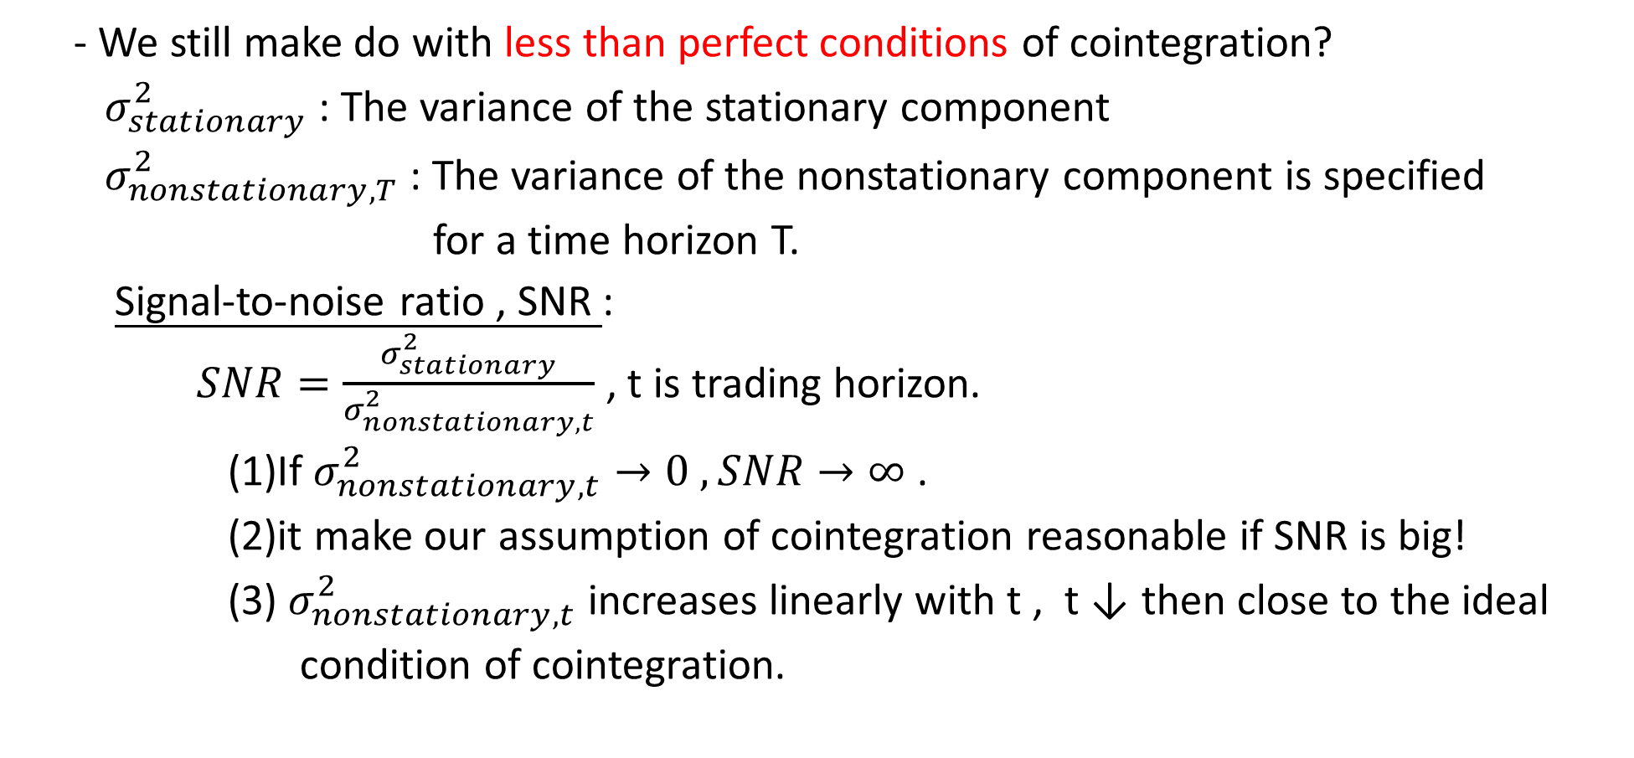
Reconciling theory and practice
- We still make do with less than perfect conditions of cointegration?
$σ_{stationary}^{2}$ : The variance of the stationary component
$σ_{nonstationary,T}^{2}$ : The variance of the nonstationary component is specified
for a time horizon T.
Signal-to-noise ratio , SNR :
$SNR=\frac{σ_{stationary}^{2}}{σ_{nonstationary,t}^{2}}$ , t is trading horizon.
(1)If $σ_{nonstationary,t}^{2}→0 , SNR→∞$ .
(2)it make our assumption of cointegration reasonable if SNR is big!
(3) $σ_{nonstationary,t}^{2}$ increases linearly with t , t ↓ then close to the ideal
condition of cointegration.
Notes:
說完定理之後 我們接這要把定理與實際操作做一個結合, 所以我們可以知道 如果CF項不是定態 整個spread就像有一個隨機drift項一樣

Slide 22
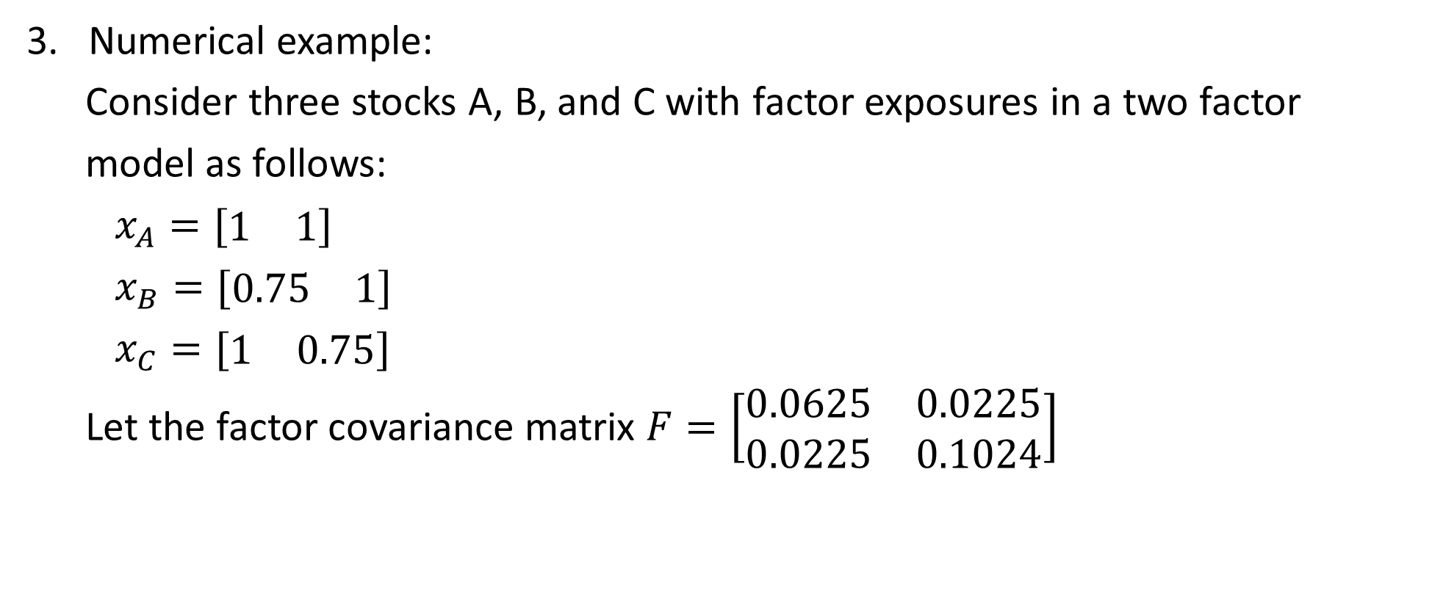
Reconciling theory and practice
Numerical example:
Consider three stocks A, B, and C with factor exposures in a two factor
model as follows:
$x_{A}=[\begin{matrix}1 & 1\end{matrix}]$
$x_{B}=[\begin{matrix}0.75 & 1\end{matrix}]$
$x_{C}=[\begin{matrix}1 & 0.75\end{matrix}]$
Let the factor covariance matrix $F=\left[\begin{matrix}0.0625 & 0.0225 \\ 0.0225 & 0.1024\end{matrix}\right]$
Notes:
說完定理之後 我們接這要把定理與實際操作做一個結合,

Slide 23
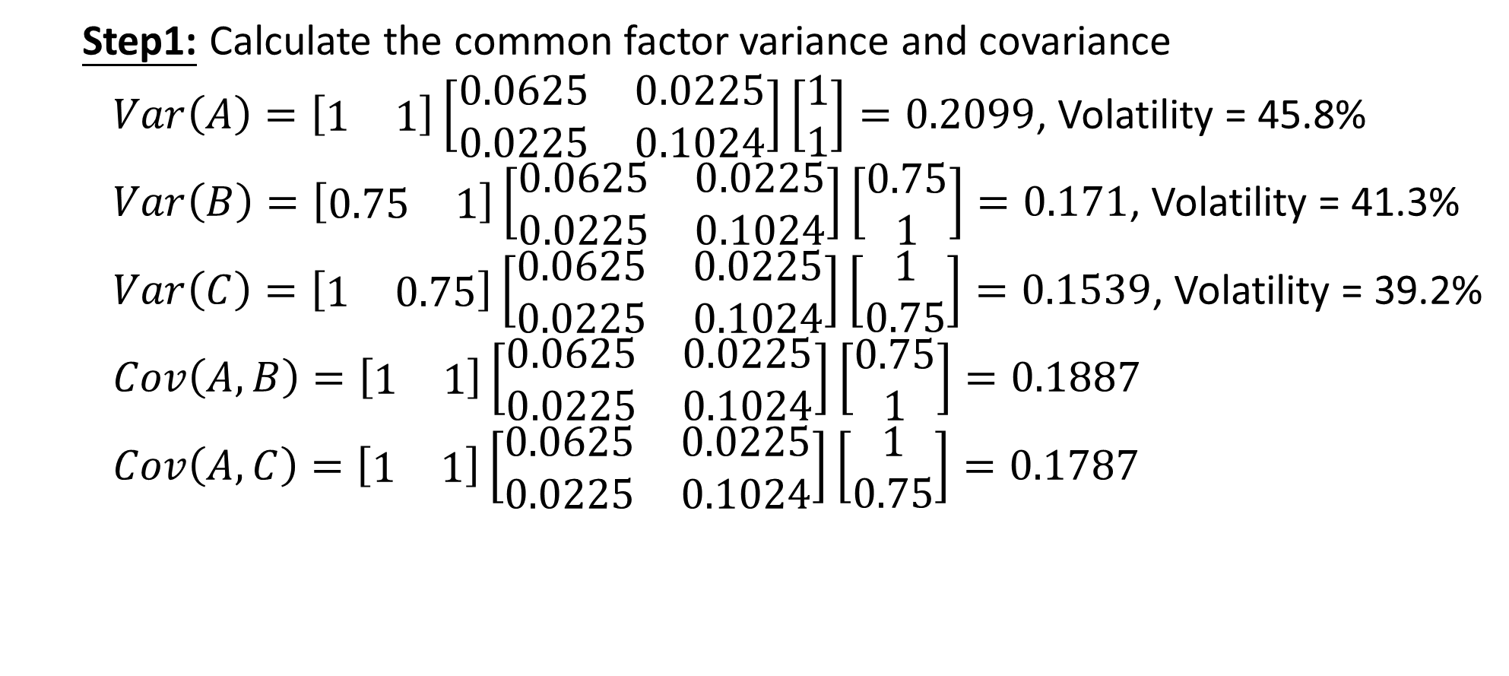
Reconciling theory and practice
Step1: Calculate the common factor variance and covariance
$Var\left(A\right)=\left[\begin{matrix}1 & 1\end{matrix}\right]\left[\begin{matrix}0.0625 & 0.0225 \\ 0.0225 & 0.1024\end{matrix}\right]\left[\begin{matrix}1 \\ 1\end{matrix}\right]=0.2099$, Volatility = 45.8%
$Var\left(B\right)=\left[\begin{matrix}0.75 & 1\end{matrix}\right]\left[\begin{matrix}0.0625 & 0.0225 \\ 0.0225 & 0.1024\end{matrix}\right]\left[\begin{matrix}0.75 \\ 1\end{matrix}\right]=0.171$, Volatility = 41.3%
$Var\left(C\right)=\left[\begin{matrix}1 & 0.75\end{matrix}\right]\left[\begin{matrix}0.0625 & 0.0225 \\ 0.0225 & 0.1024\end{matrix}\right]\left[\begin{matrix}1 \\ 0.75\end{matrix}\right]=0.1539$, Volatility = 39.2%
$Cov\left(A,B\right)=\left[\begin{matrix}1 & 1\end{matrix}\right]\left[\begin{matrix}0.0625 & 0.0225 \\ 0.0225 & 0.1024\end{matrix}\right]\left[\begin{matrix}0.75 \\ 1\end{matrix}\right]=0.1887$
$Cov\left(A,C\right)=\left[\begin{matrix}1 & 1\end{matrix}\right]\left[\begin{matrix}0.0625 & 0.0225 \\ 0.0225 & 0.1024\end{matrix}\right]\left[\begin{matrix}1 \\ 0.75\end{matrix}\right]=0.1787$
Notes:
說完定理之後 我們接這要把定理與實際操作做一個結合,

Slide 24
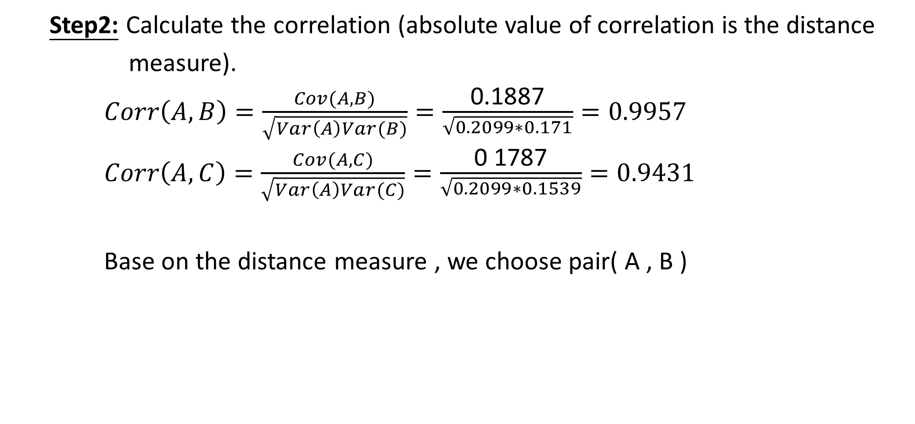
Reconciling theory and practice
Step2: Calculate the correlation (absolute value of correlation is the distance
measure).
$Corr\left(A,B\right)=\frac{Cov(A,B)}{\sqrt{Var\left(A\right)Var(B)}}=\frac{\text{0}\text{.}\text{1887}}{\sqrt{0.2099∗0.171}}=0.9957$
$Corr\left(A,C\right)=\frac{Cov(A,C)}{\sqrt{Var\left(A\right)Var(C)}}=\frac{\text{0 1787}}{\sqrt{0.2099∗0.1539}}=0.9431$
Base on the distance measure , we choose pair( A , B )
Notes:
說完定理之後 我們接這要把定理與實際操作做一個結合,

Slide 25
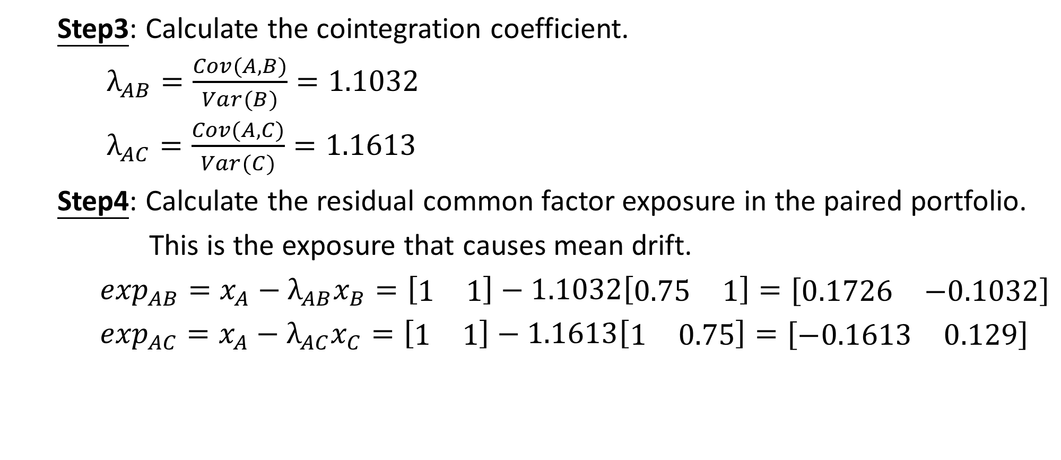
Reconciling theory and practice
Step3: Calculate the cointegration coefficient.
$λ_{AB}=\frac{Cov(A,B)}{Var(B)}=1.1032$
$λ_{AC}=\frac{Cov(A,C)}{Var(C)}=1.1613$
Step4: Calculate the residual common factor exposure in the paired portfolio.
This is the exposure that causes mean drift.
$\exp_{AB}=x_{A}−λ_{AB}x_{B}=\left[\begin{matrix}1 & 1\end{matrix}\right]−1.1032\left[\begin{matrix}0.75 & 1\end{matrix}\right]=[\begin{matrix}0.1726 & −0.1032\end{matrix}]$
$\exp_{AC}=x_{A}−λ_{AC}x_{C}=\left[\begin{matrix}1 & 1\end{matrix}\right]−1.1613\left[\begin{matrix}1 & 0.75\end{matrix}\right]=[\begin{matrix}−0.1613 & 0.129\end{matrix}]$
Notes:
說完定理之後 我們接這要把定理與實際操作做一個結合,

Slide 26
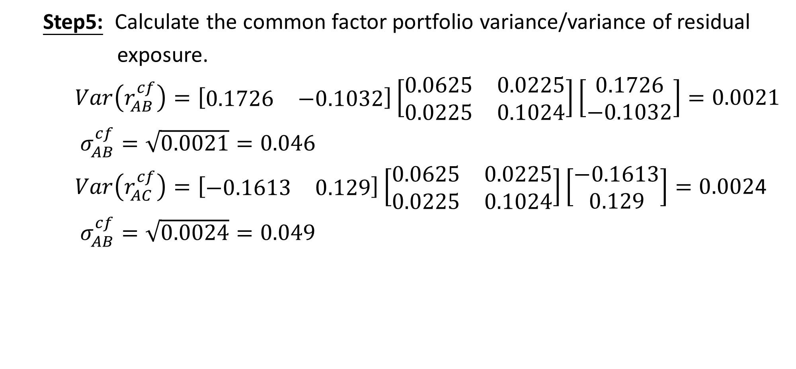
Reconciling theory and practice
Step5: Calculate the common factor portfolio variance/variance of residual
exposure.
$Var\left(r_{AB}^{cf}\right)=\left[\begin{matrix}0.1726 & −0.1032\end{matrix}\right]\left[\begin{matrix}0.0625 & 0.0225 \\ 0.0225 & 0.1024\end{matrix}\right]\left[\begin{matrix}0.1726 \\ −0.1032\end{matrix}\right]=0.0021$
$σ_{AB}^{cf}=\sqrt{0.0021}=0.046$
$Var\left(r_{AC}^{cf}\right)=\left[\begin{matrix}−0.1613 & 0.129\end{matrix}\right]\left[\begin{matrix}0.0625 & 0.0225 \\ 0.0225 & 0.1024\end{matrix}\right]\left[\begin{matrix}−0.1613 \\ 0.129\end{matrix}\right]=0.002$4
$σ_{AB}^{cf}=\sqrt{0.0024}=0.049$
Notes:
說完定理之後 我們接這要把定理與實際操作做一個結合,

Slide 27
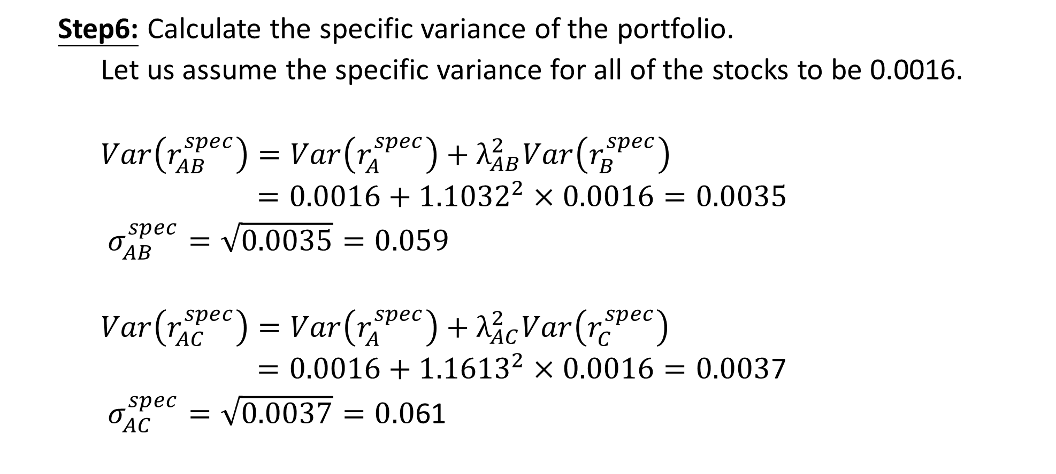
Reconciling theory and practice
Step6: Calculate the specific variance of the portfolio.
Let us assume the specific variance for all of the stocks to be 0.0016.
$Var\left(r_{AB}^{spec}\right)=Var\left(r_{A}^{spec}\right)+λ_{AB}^{2}Var\left(r_{B}^{spec}\right)$
$=0.0016+{1.1032}^{2}×0.0016=0.0035$
$σ_{AB}^{spec}=\sqrt{0.0035}=0.059$
$Var\left(r_{AC}^{spec}\right)=Var\left(r_{A}^{spec}\right)+λ_{AC}^{2}Var\left(r_{C}^{spec}\right)$
$=0.0016+{1.1613}^{2}×0.0016=0.003$7
$σ_{AC}^{spec}=\sqrt{0.0037}=0.0$61
Notes:
說完定理之後 我們接這要把定理與實際操作做一個結合,

Slide 28
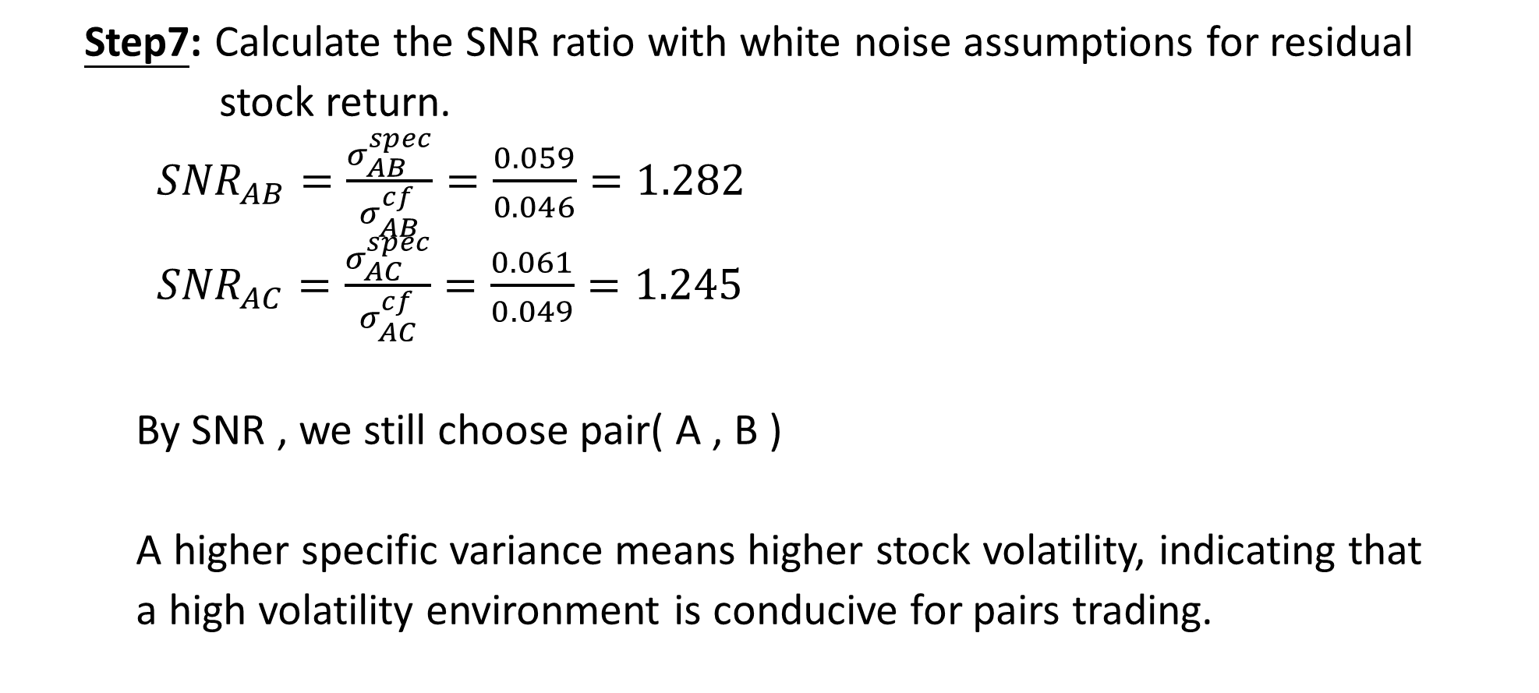
Reconciling theory and practice
Step7: Calculate the SNR ratio with white noise assumptions for residual
stock return.
${SNR}_{AB}=\frac{σ_{AB}^{spec}}{σ_{AB}^{cf}}=\frac{0.059}{0.046}=1.282$
${SNR}_{AC}=\frac{σ_{AC}^{spec}}{σ_{AC}^{cf}}=\frac{0.061}{0.049}=1.245$
By SNR , we still choose pair( A , B )
A higher specific variance means higher stock volatility, indicating that
a high volatility environment is conducive for pairs trading.
Notes:
說完定理之後 我們接這要把定理與實際操作做一個結合,

